Slide 1
Machine To Human Vision
Sami Bensellam Alexander Stoytchev | Client Advisor
Sami Bensellam Alexander Black Jacob Burns Yogi Chander Jacob Lyons Sergio Perez-Valentin | Project Lead Hardware Lead and Component Assembly Software Development Software/Hardware Integration Component and System Design Software Lead and Component Testing

Slide 2
01
PROJECT SCOPE

Slide 3
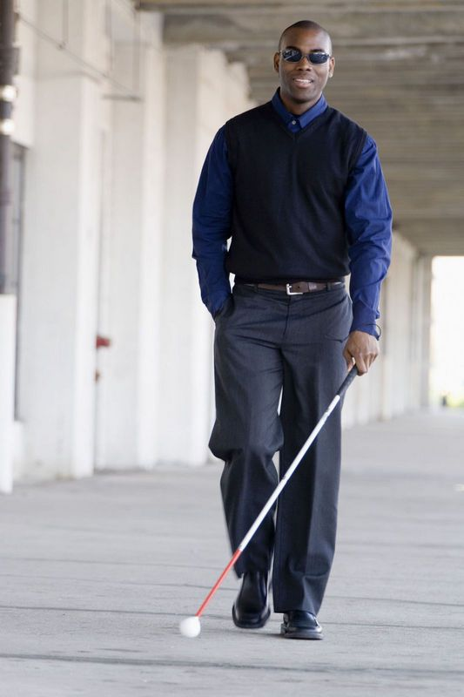
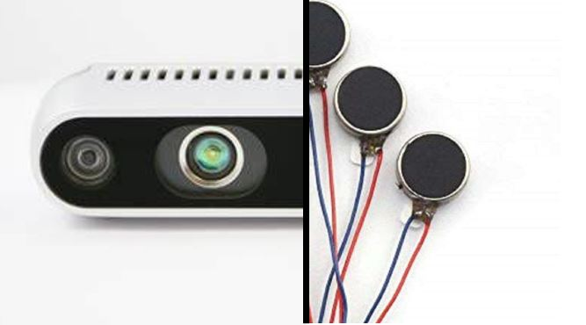
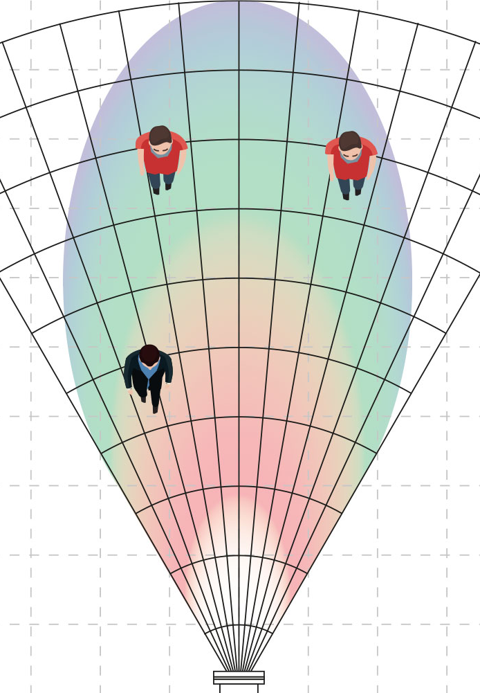
PROJECT VISION
WHO
WHAT
WHY
Visually impaired individuals, ranging from partial blindness to complete blindness.
An interface by which users receive vital information about their environment.
Help users perceive objects and surroundings similar to that of someone with normal eyesight.

Slide 4
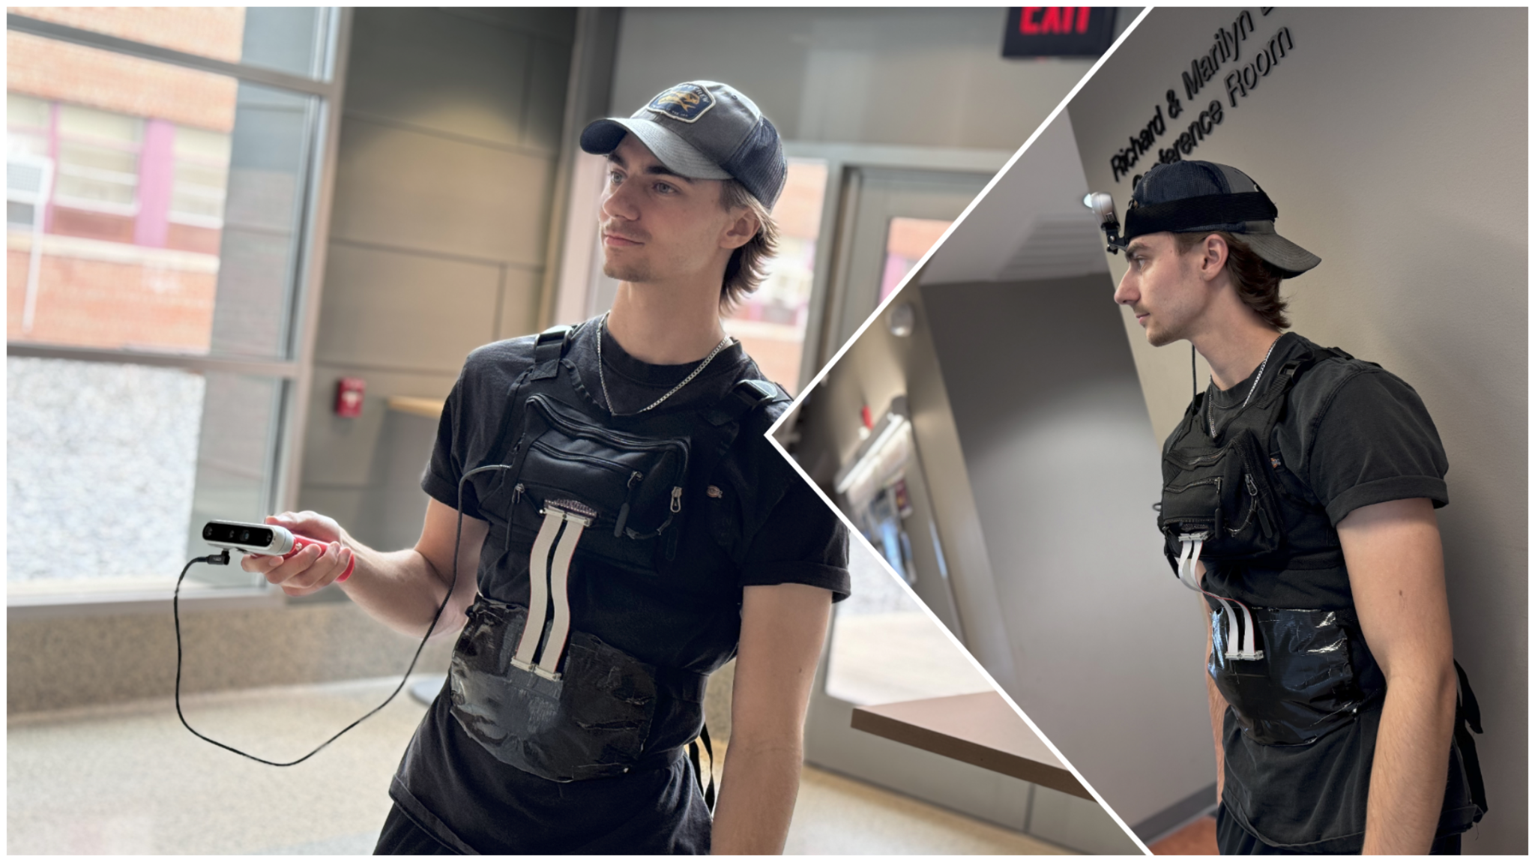

Slide 5
HIGH LEVEL CONCEPT
1m = 90%
7m = 30%
1m = 90%
3m = 70%
1 meter
7 meters
1 meter
3 meters
1m = 90%
6m = 40%
1m = 90%
3m = 70%
1 meter
4 meters
1 meter
3 meters

Slide 6
02
REQUIREMENTS

Slide 7
FUNCTIONAL REQUIREMENTS
Stereo camera shall track objects up to 5 meters.
Stereo camera shall refresh at minimum rate of 15 Hz.
Haptic rig shall have enough resolution to distinguish direction of nearest objects.
Haptic rig shall have response time below 200 ms.
Haptic rig shall map vibration frequency relative to distance.

Slide 8
USABILITY REQUIREMENTS
System shall be simple to assemble and put on.
System shall be wearable for extended periods.
System shall be have a sleek and low profile design.
System shall be usable in indoor and outdoor environments.
System shall have a runtime of at least 2 hours.

Slide 9
03
DESIGN
COMPONENTS

Slide 10
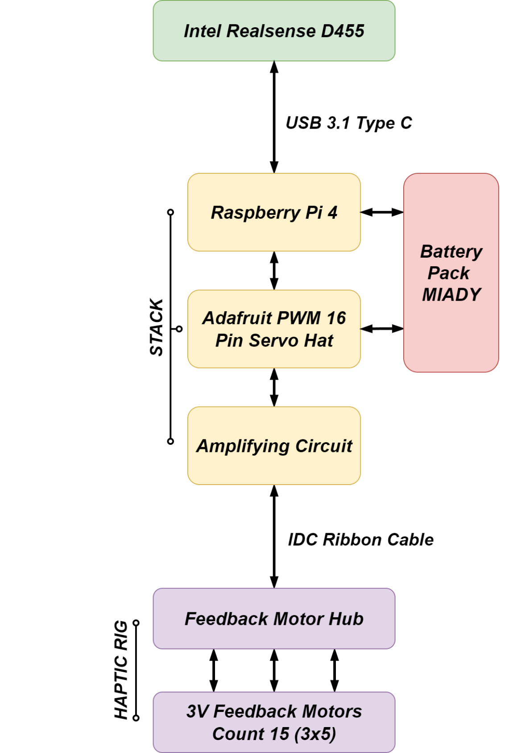
STEREO CAMERA
Capture images and depth data from user’s surroundings.
640 x 480 pixel output, 19 MB per second
Data is output to the Raspberry Pi via USB 3

Slide 11
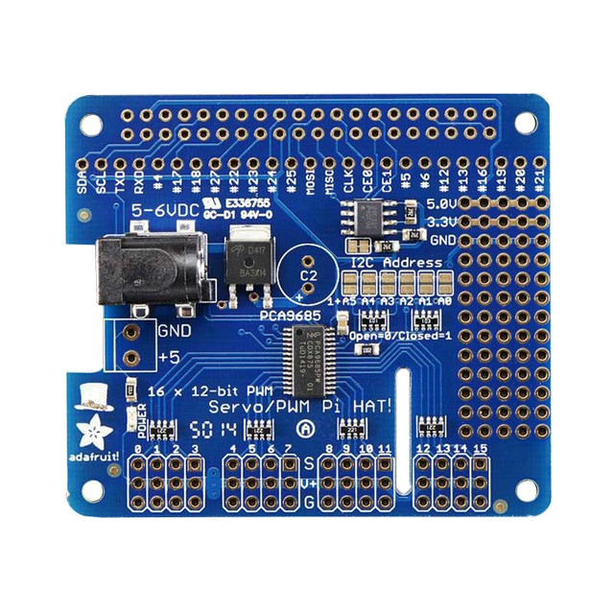
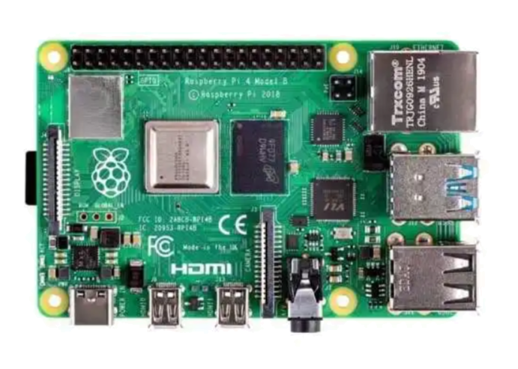
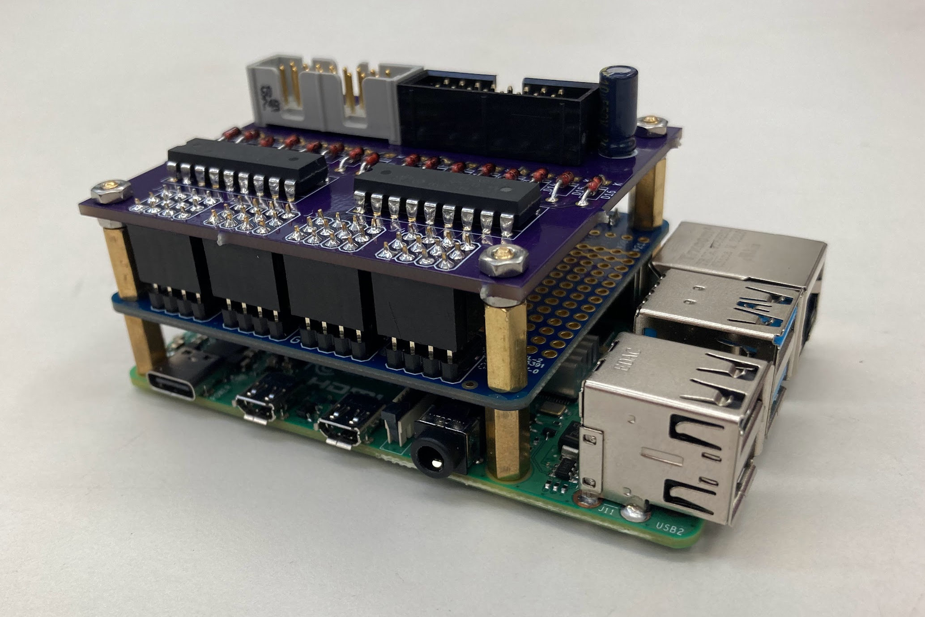
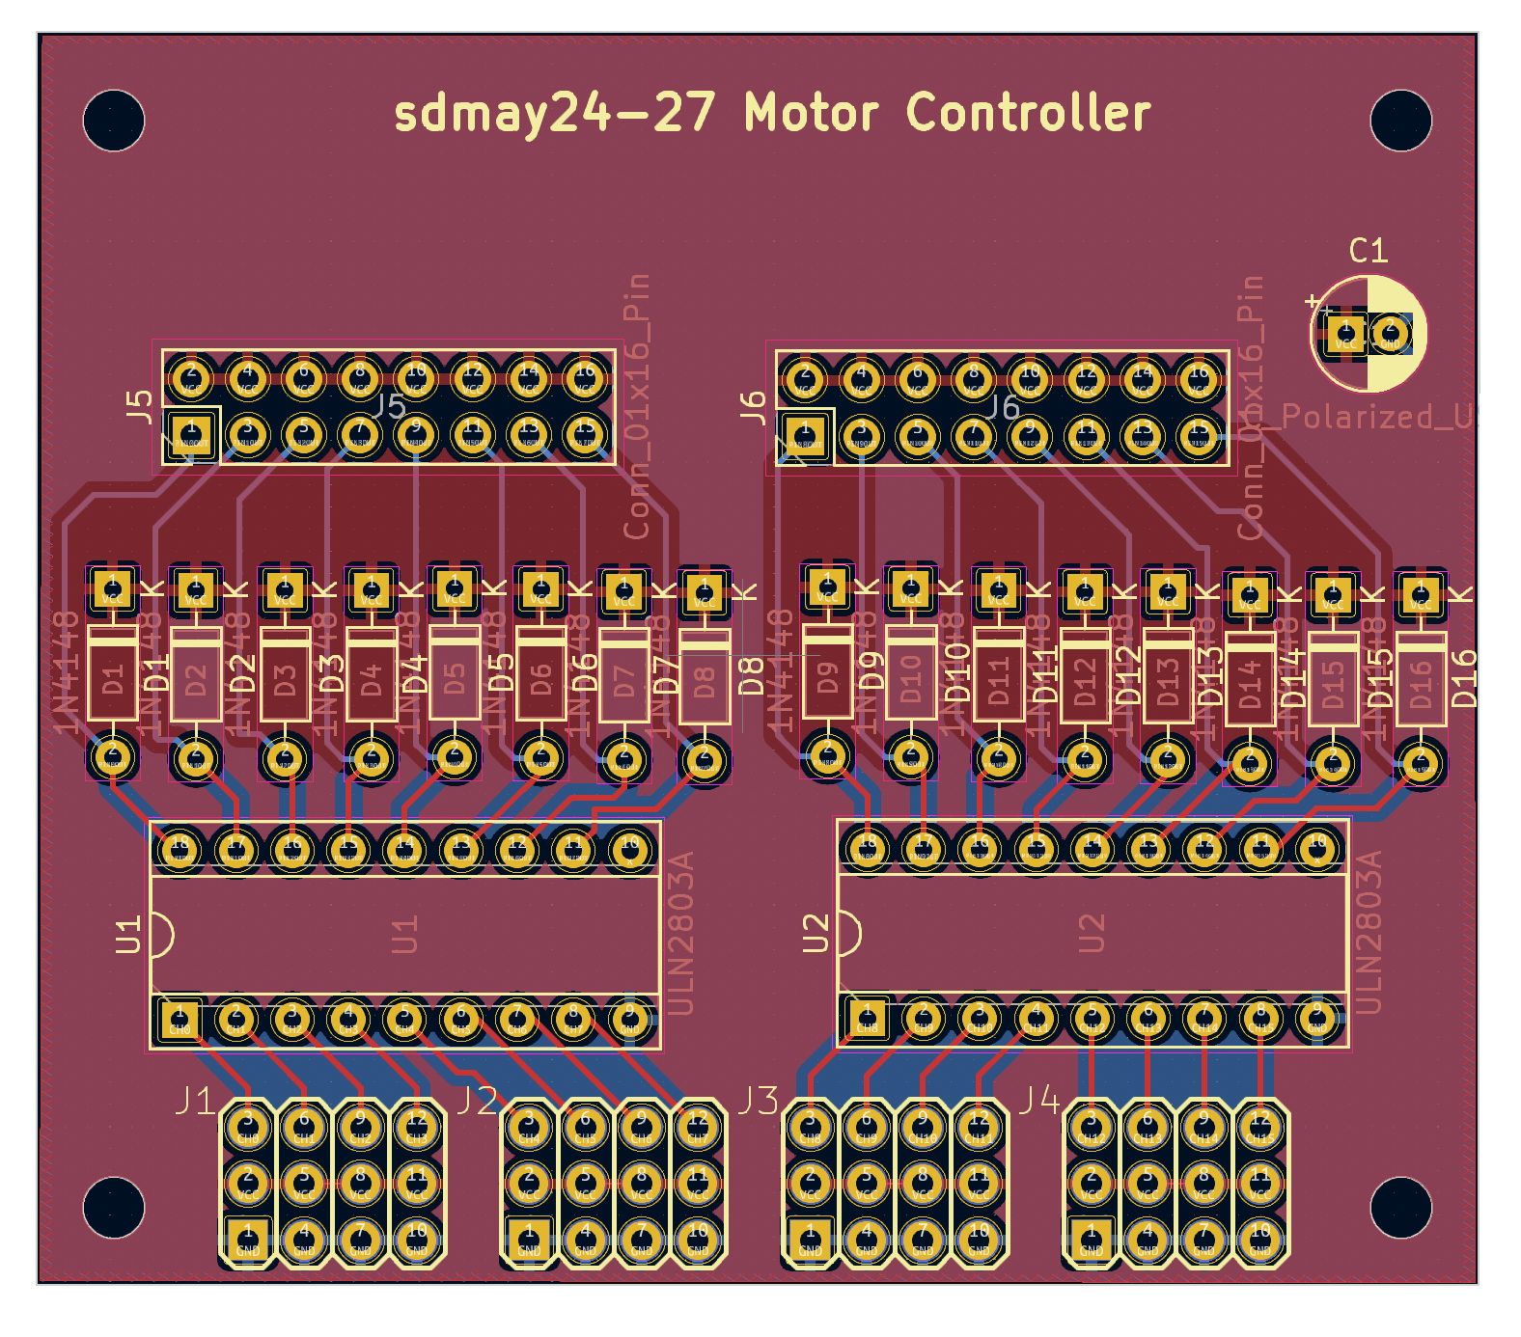
COMPUTE STACK
Raspberry pi contains python scripts that process depth data
Adafruit servo/pwm pi hat fitted onto Raspberry pi for more PWM output pins
Amplifying circuit board fitted on top of Adafruit hat to amplify output amperage

Slide 12
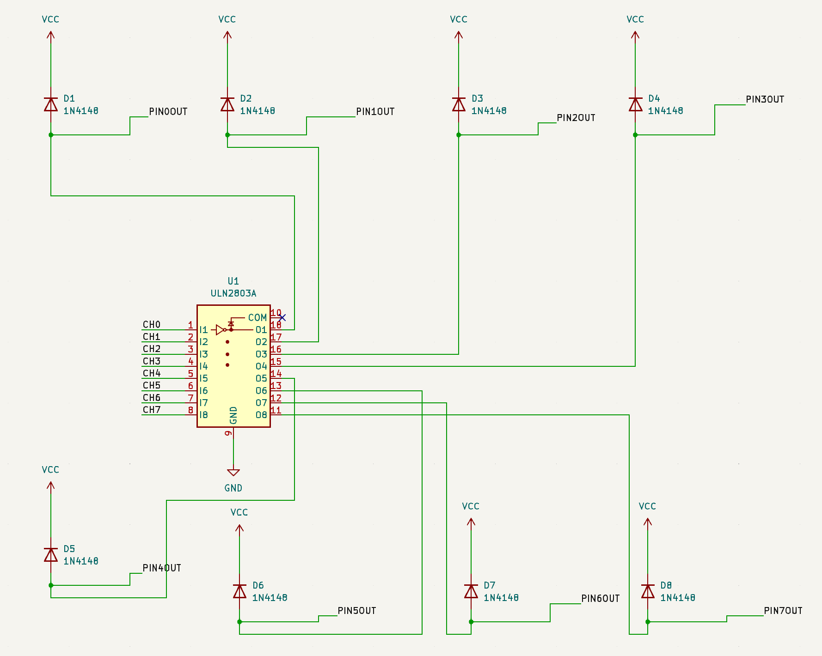
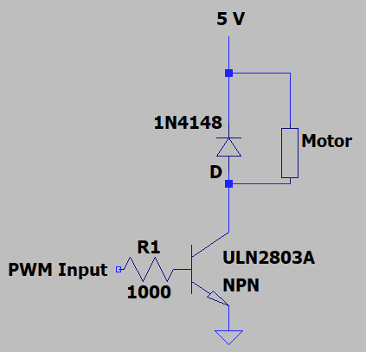
AMPLIFYING CIRCUIT
Circuit uses transistors and diode to amplify output current
On PCB circuit, a transistor array piece was used to save space
Final circuit board can be directly fitted onto Adafruit board

Slide 13
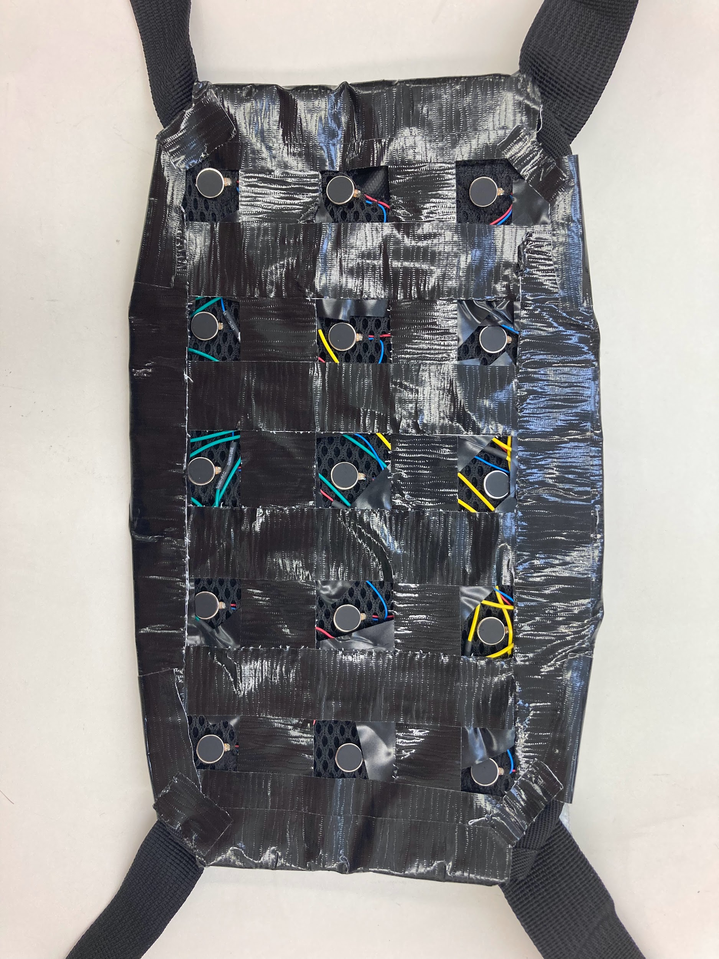
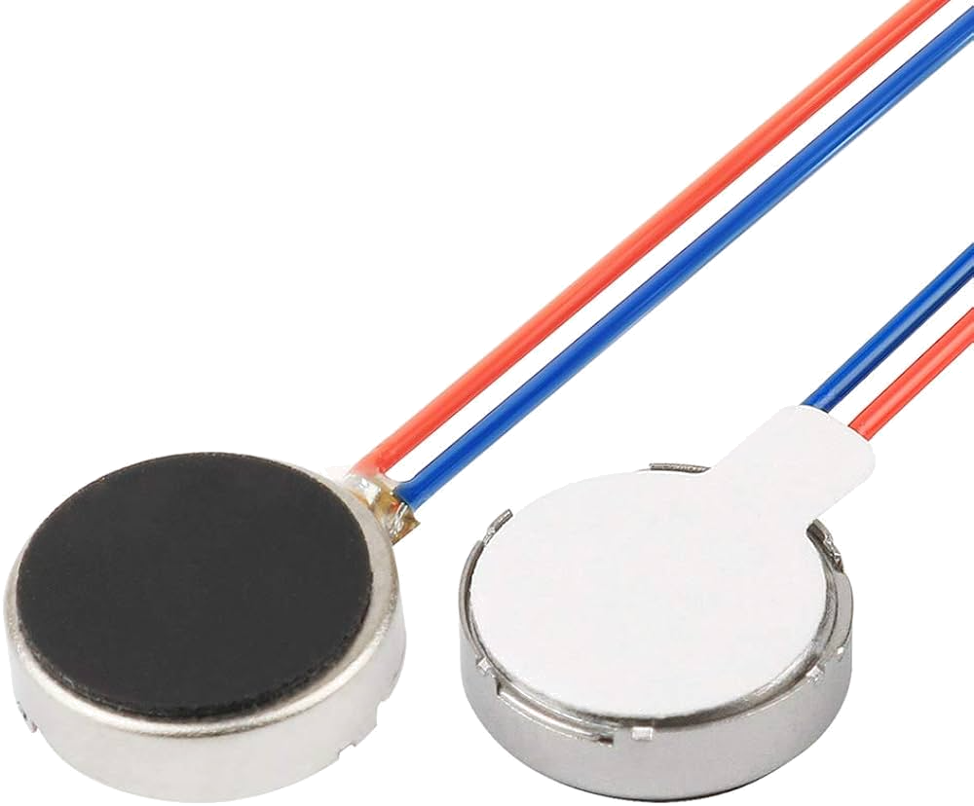
HAPTIC RIG
Haptic motors embedded into haptic rig.
Rig is fastened onto torso of the user. Rig connected via ribbon cable.
Motors vibrate at 3V max.

Slide 14
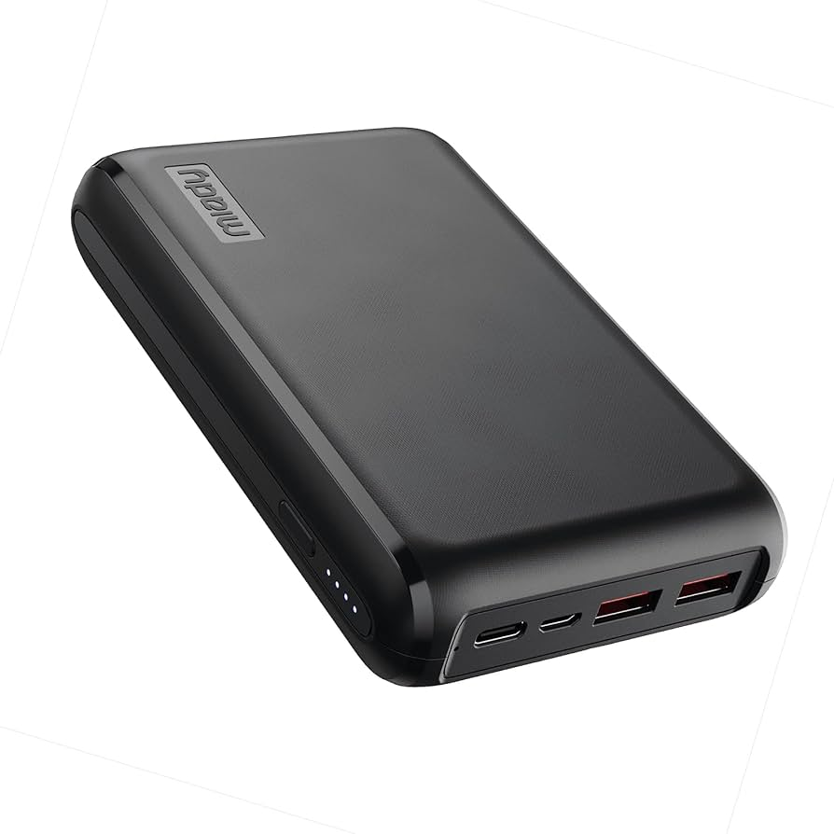
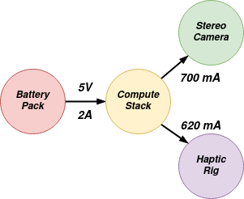
BATTERY
The battery powers the Raspberry Pi, which in turn powers the rest of the device.
Device battery life of eight hours with current electrical configuration.
Battery pack outputs 5V / 2.1 amps.

Slide 15
04
SOFTWARE

Slide 16
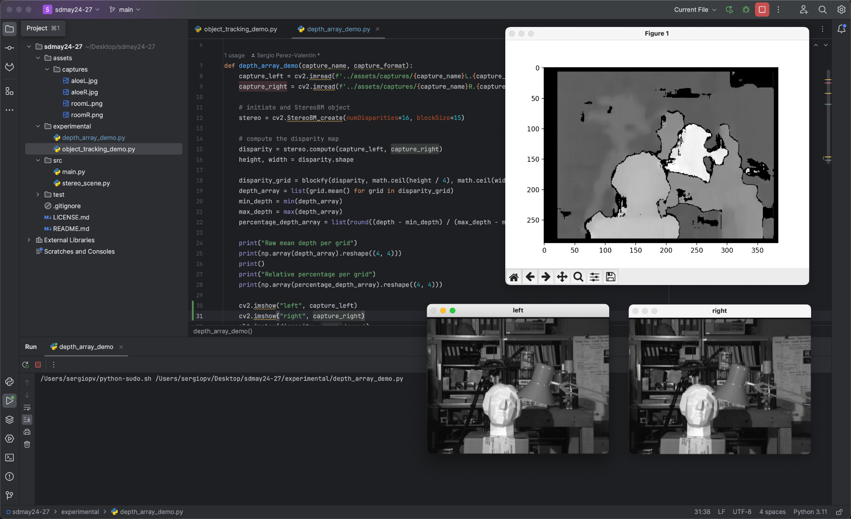
FRAMEWORKS
OS: Network blocked Ubuntu instance.
Scripts: Python3
Libraries: OpenCV, NumPy, Pyrealsense2, adafruitpca9685

Slide 17
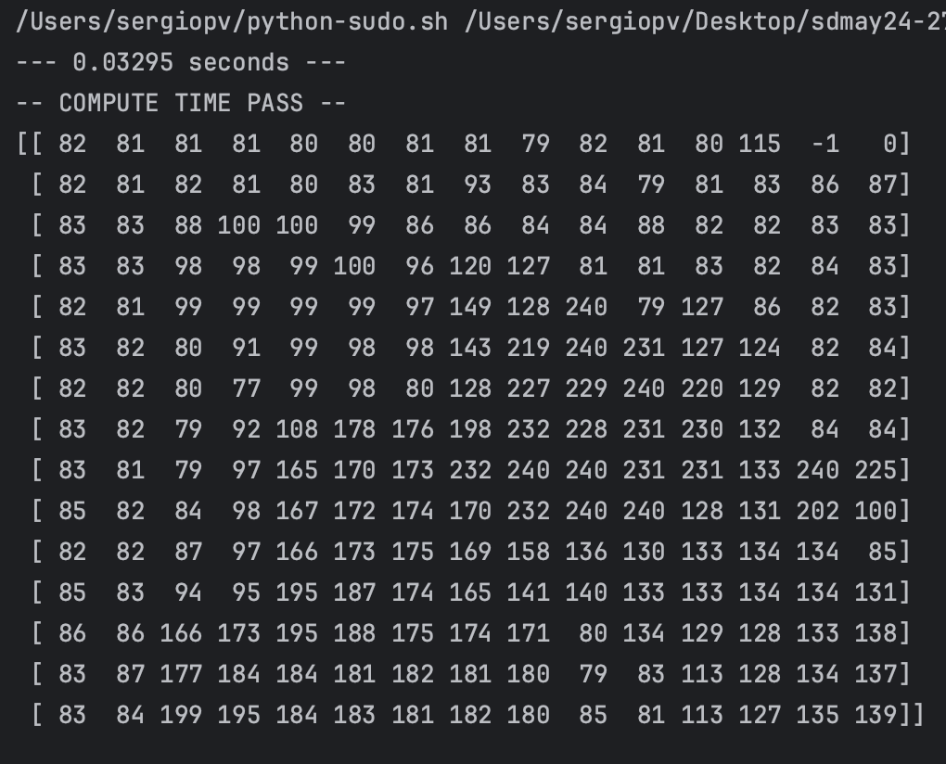
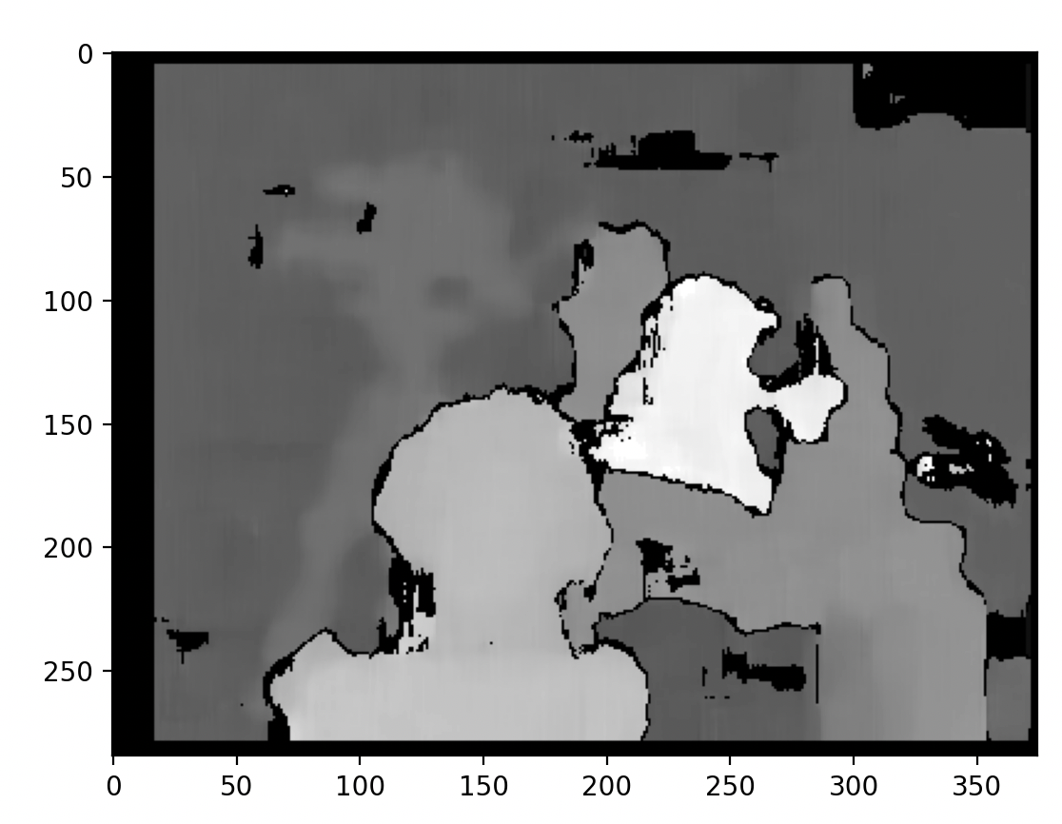
INSTANCE LOGIC
Average 18 fps.
Per instance:
Capture depth map.
Split into cells.
Calculate closest prominent depth point.
Translate to vibration percentage.
* LARGER NUMBER = CLOSER DEPTH

Slide 18
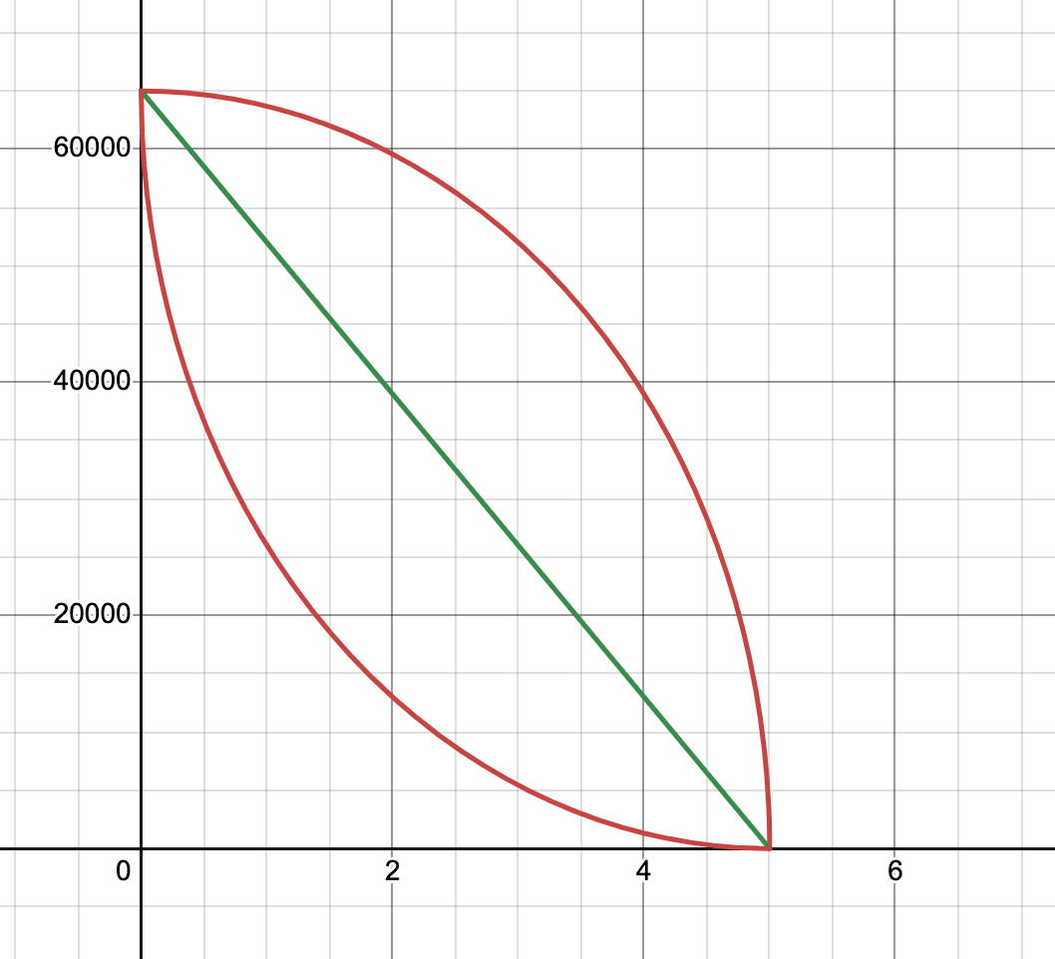
VIBRATION TRANSLATION
FUNCTION
Vibration level
Distance

Slide 19
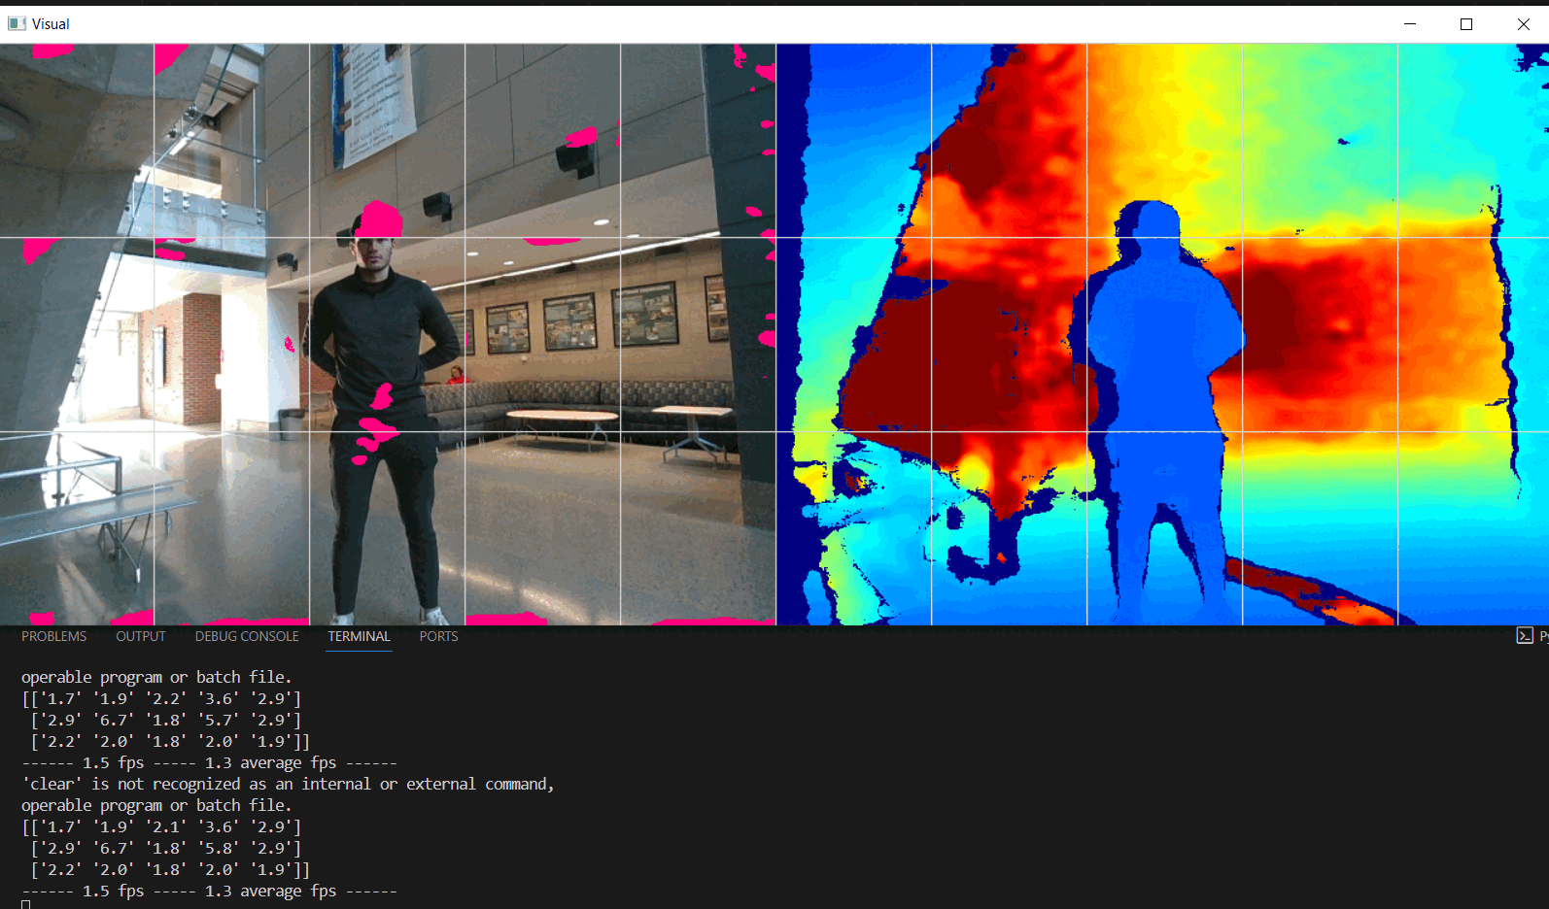
CAMERA VISUALIZATION

Slide 20
05
IMPLEMENTATION

Slide 21
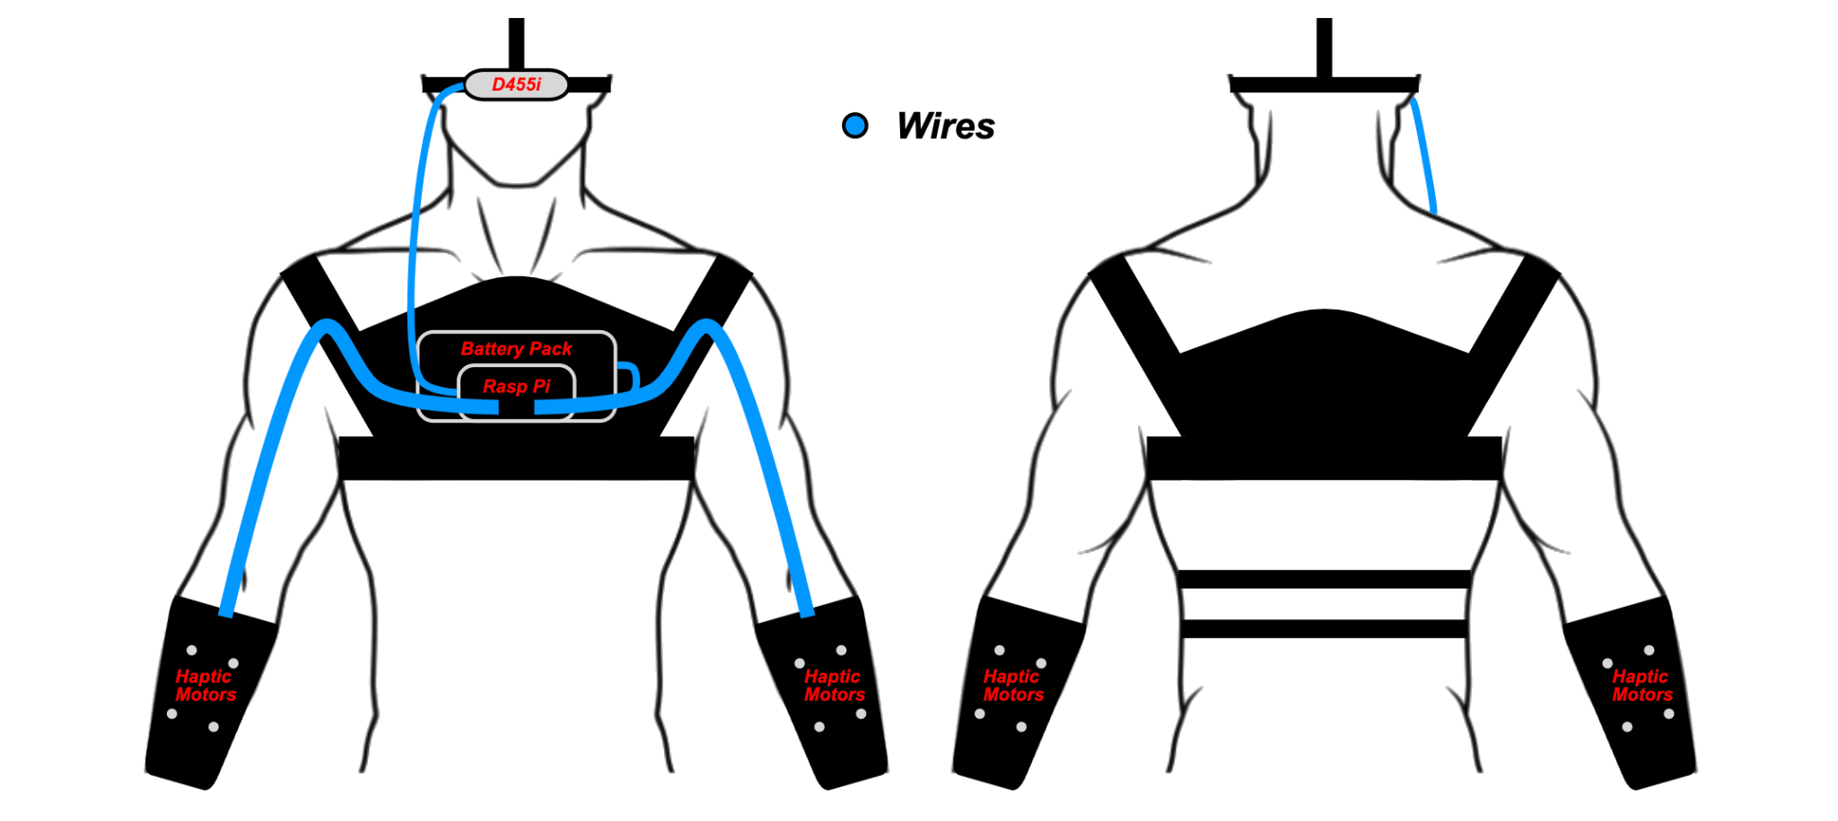
INITIAL CONCEPT GRAPHIC

Slide 22
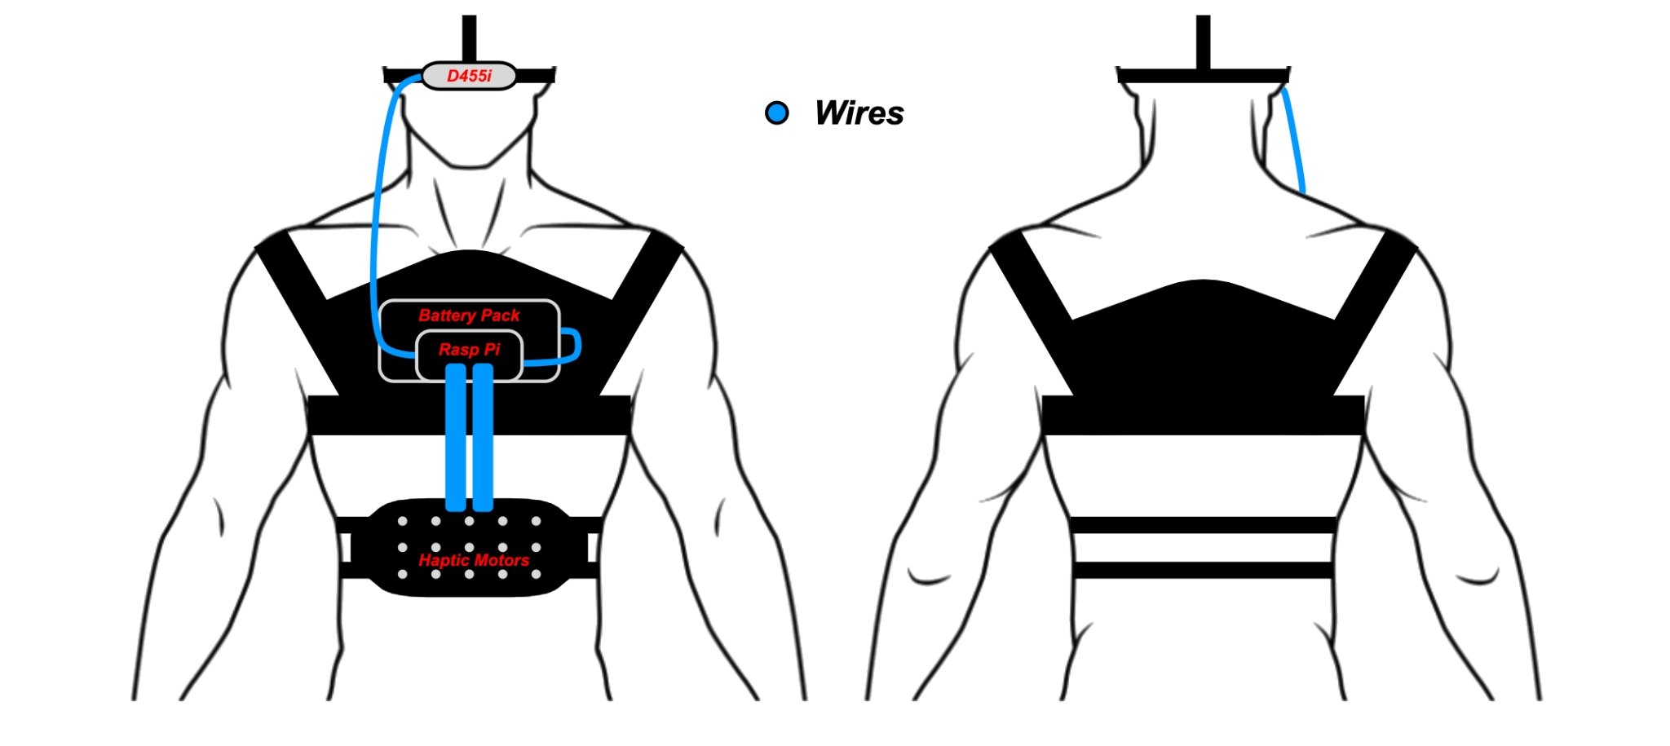
FINAL CONCEPT GRAPHIC

Slide 23
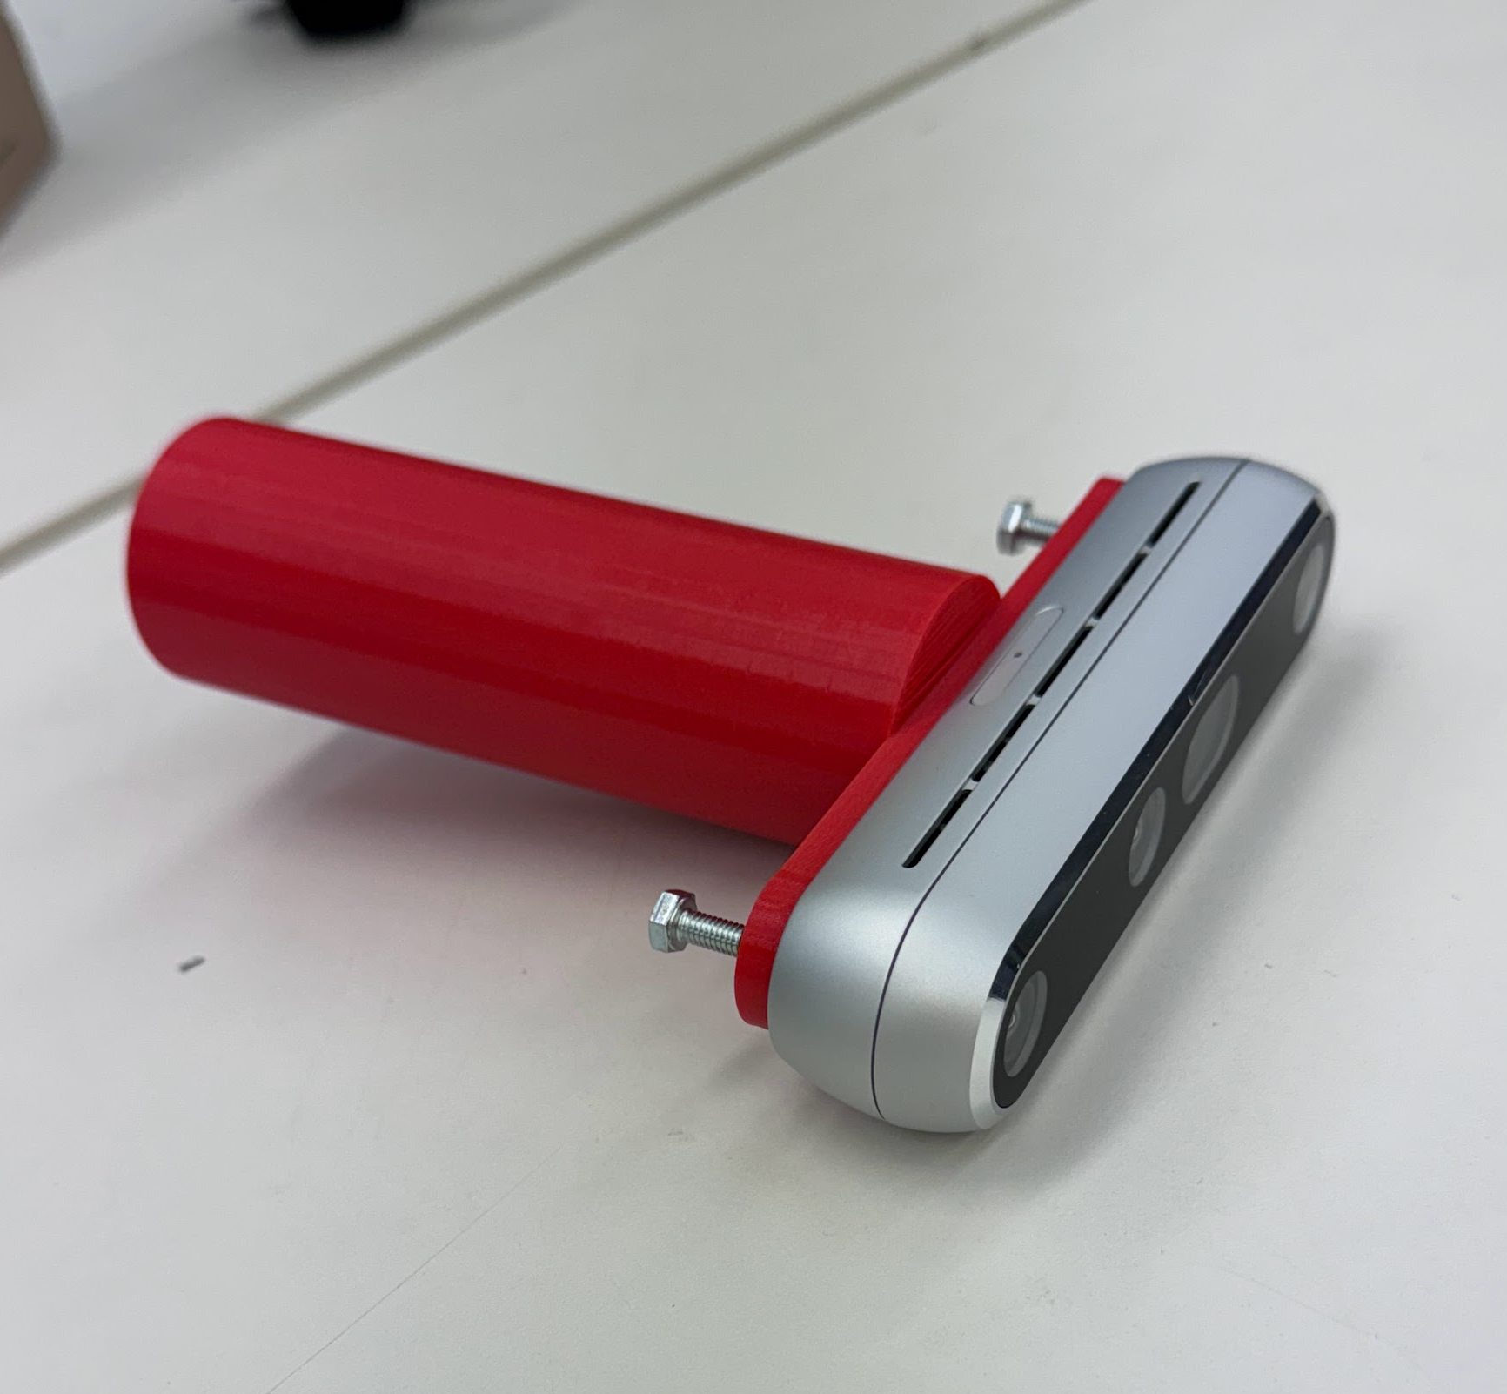
CLOTHING MODULES
Haptic Rig
Chest Rig
Camera Mount
Handle
Feedback motor grid integrated into lining.
Houses Raspberry Pi and battery pack.
Pre-existing head strap to mount D455 camera.
Additional 3D printed
handle as a substitute to
the camera mount

Slide 24
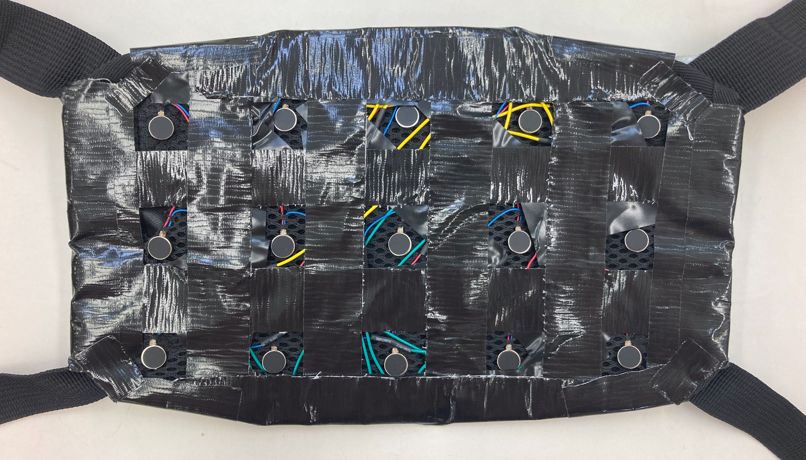
HAPTIC RIG
Feedback motor grid of 3x5.
Covers top to bottom, left to right.
Feedback motors wire to central hub. Hub connects to compute stack with IDC.
Sleek and adjustable to different sized users.

Slide 25
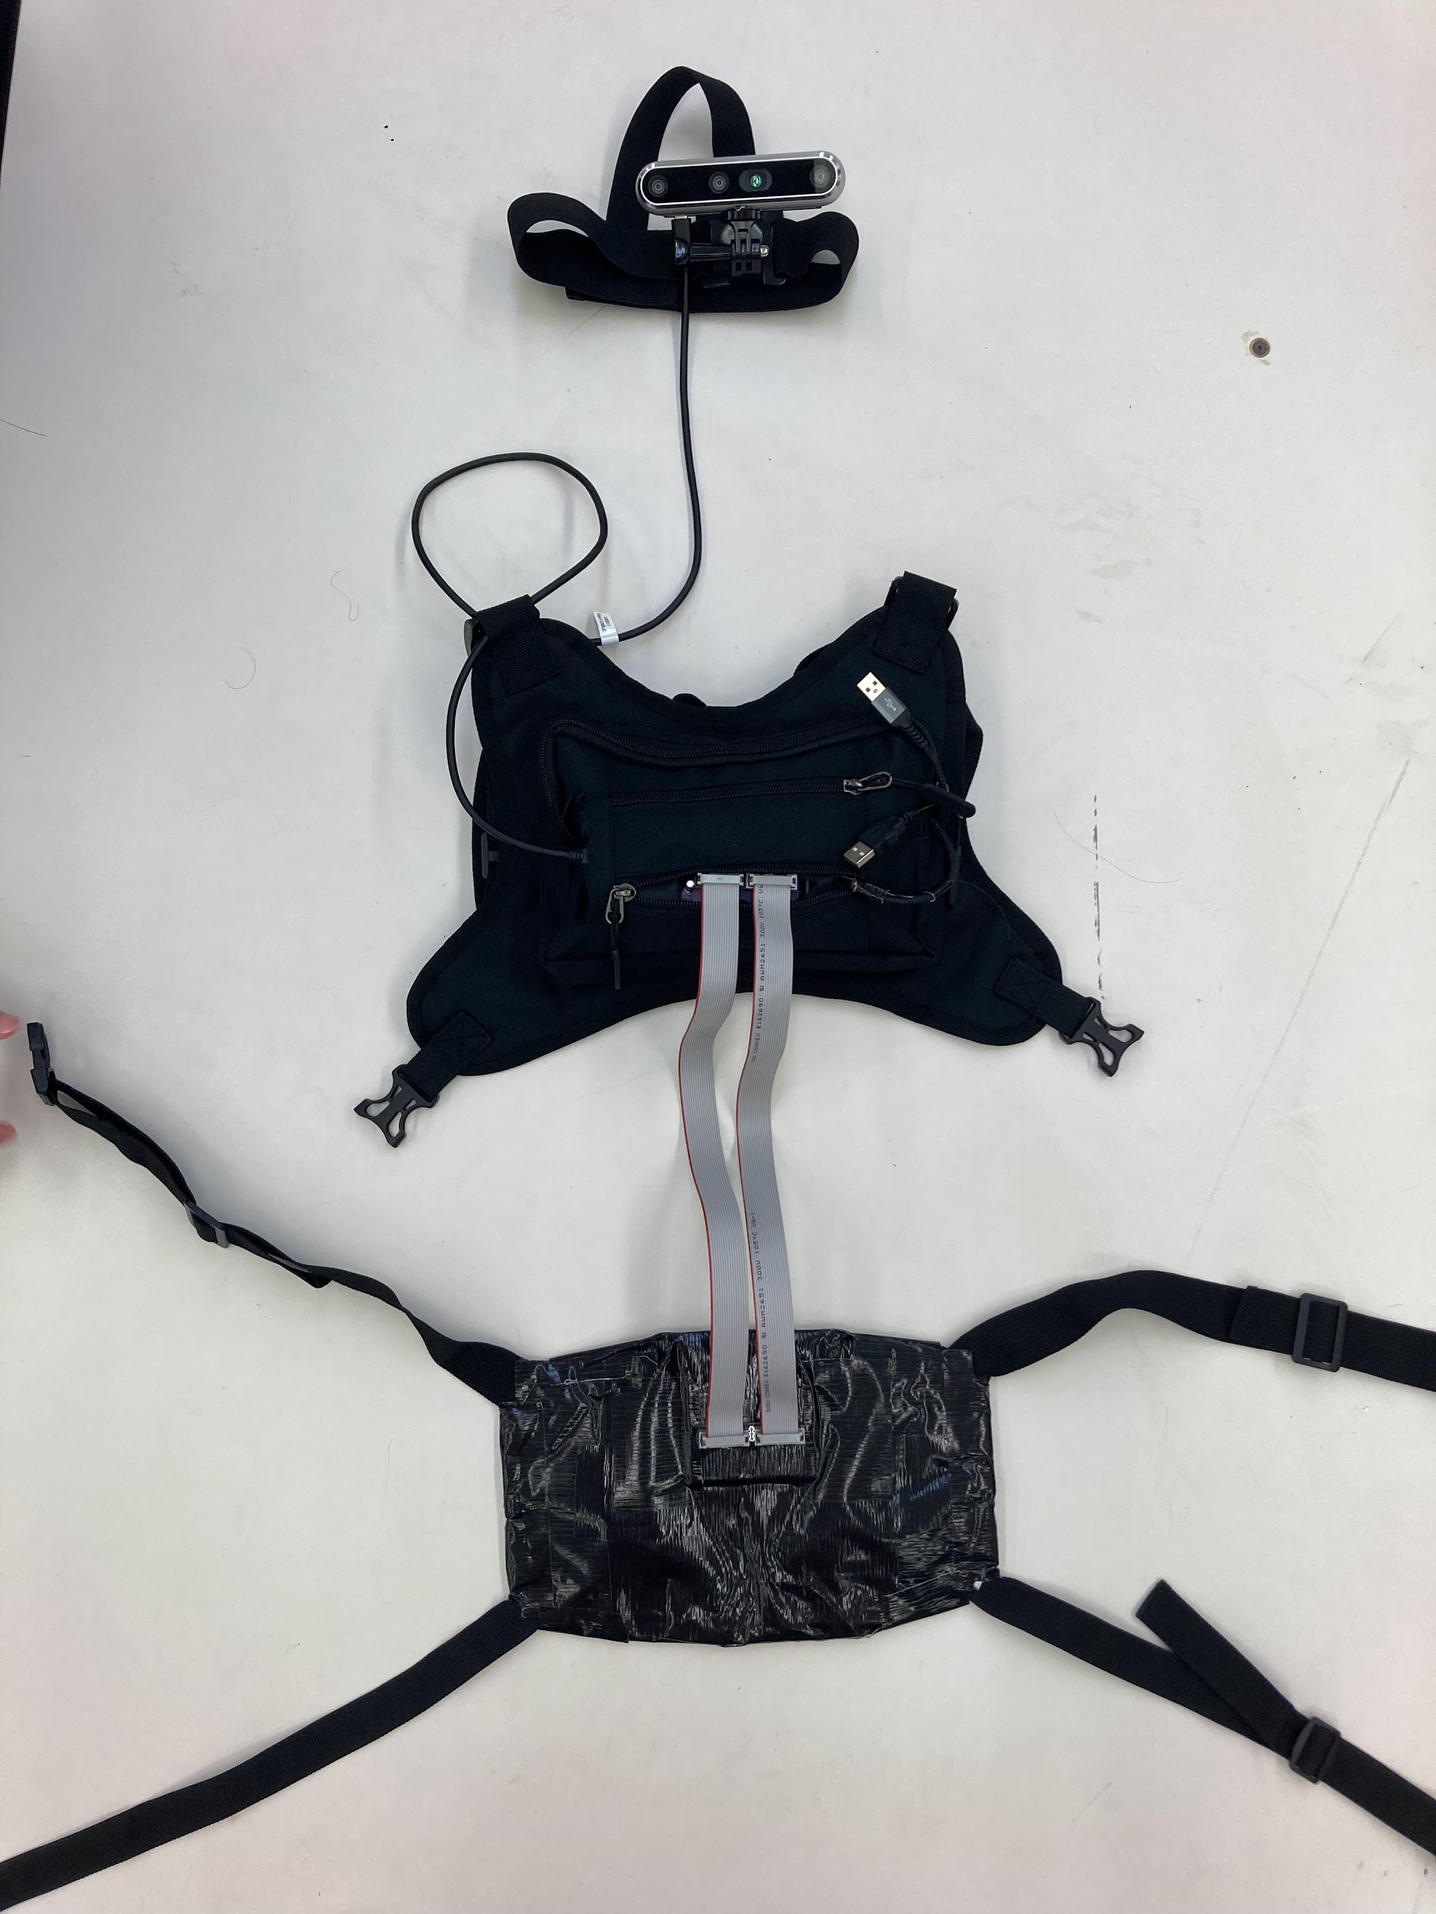
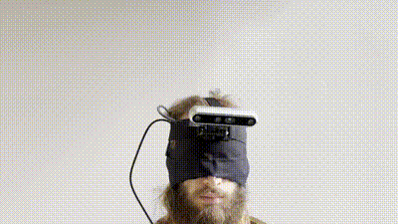
IMPLEMENTATION RESULT

Slide 26
06
TESTING

Slide 27
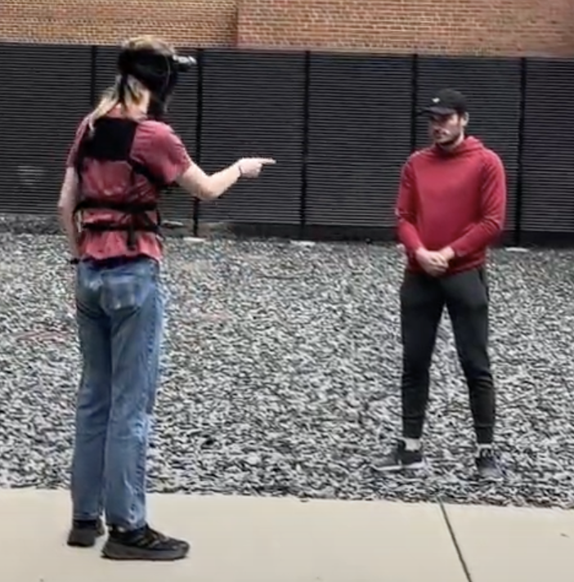
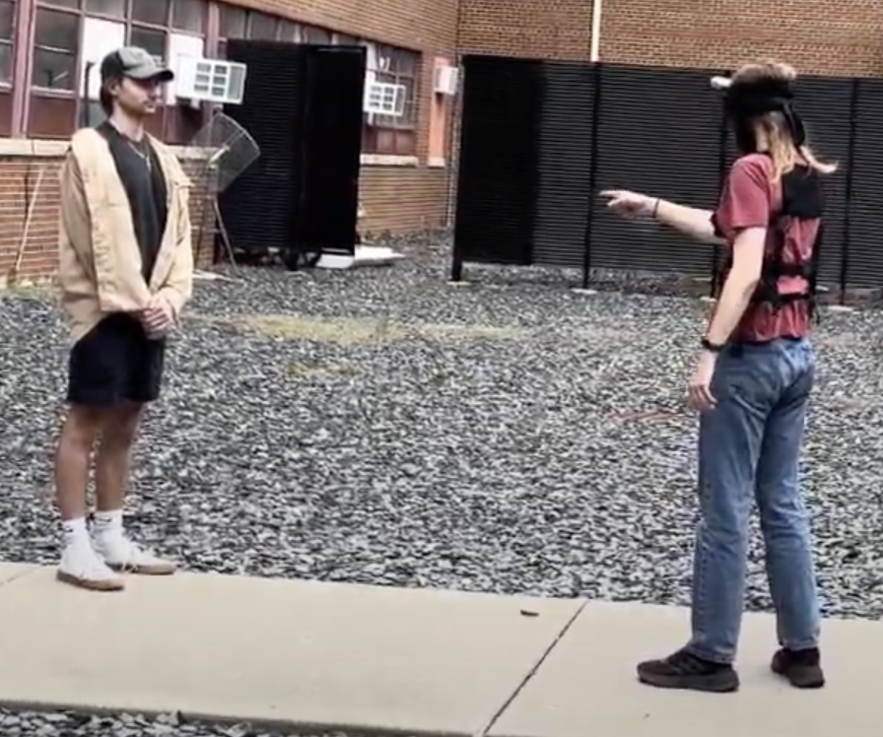
UNIT
TESTING
Framerate testing found scripts operates at 18 fps without visualization, 1.5 fps with visualization.
Battery lasts for more than 2 hours of continuous operation.
Camera depth measurements tested via measuring tape and found to be accurate.

Slide 28
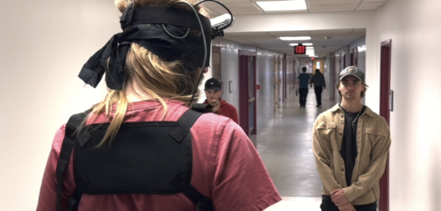
INTERFACE
TESTING
While wearing the device, user can accurately detect and navigate around objects in front of them.
User can register and respond to sudden changes in environment.
Motors vibrations are reliable and precise.

Slide 29
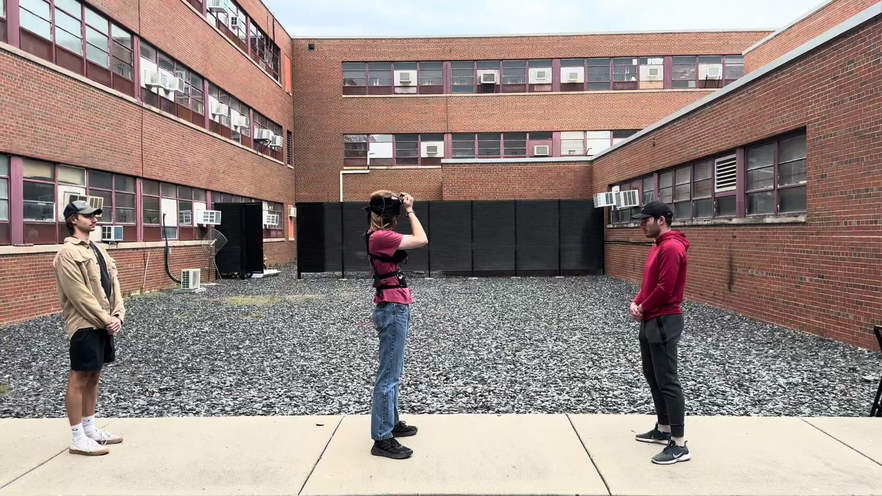
TESTING RESULTS

Slide 30
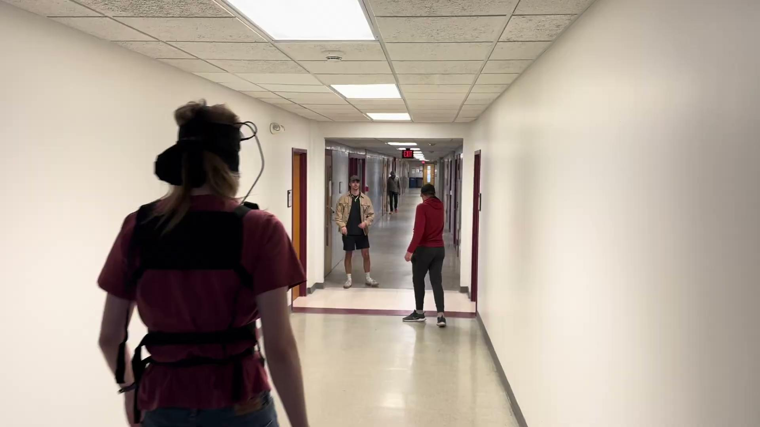
TESTING RESULTS

Slide 31
THANK YOU
Do you have any questions?
sdmay24-27@iastate.edu https://sdmay24-27.sd.ece.iastate.edu/ | Contact Website
Acknowledgments | Lee Harker Project Advisor Alexander Stoychev Electrical Engineering Professor Liang Dong Mohammad al-Araidah
Please keep this slide for attribution

